Slide 1
High Recycle with WMA Fatigue Cracking Experiment
AFD40(2) - April 11, 2013
Nelson Gibson, Ph.D., P.E.
FHWA Office of Infrastructure R&D

Slide 2
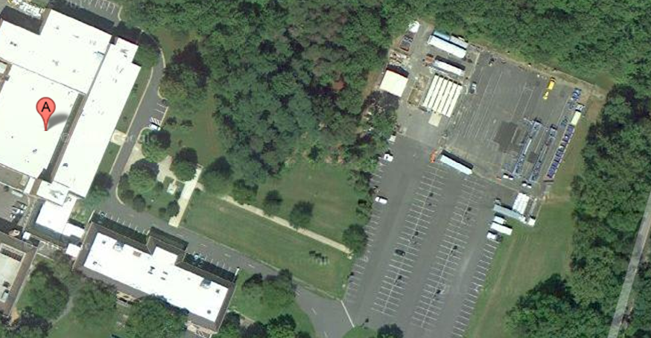
Facility Overview

Slide 3
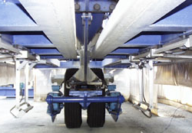
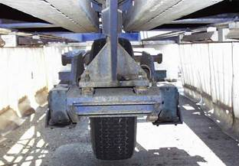
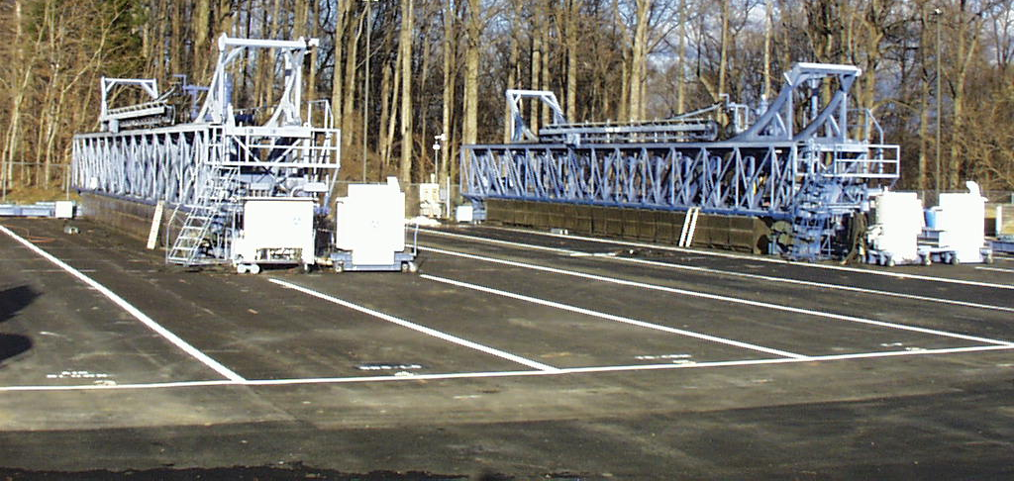
Facility Overview

Slide 4
Past Accomplishments
Influence of Tire Type on Performance
Original Superpave Binder Validation
Ultrathin WhiteTopping
Revised Superpave Binder Validation
Delay of Top-Down Cracking with 4.75mm NMAS Overlay

Slide 5
Fully Published Final Report
http://www.fhwa.dot.gov/publications/research/infrastructure/pavements/11045/index.cfm

Slide 6
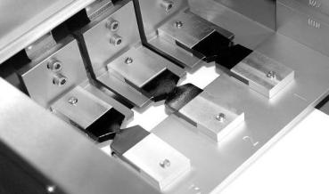
Recommended Test for Fatigue Cracking
DENT = Double Edge Notched Tension
CTOD = Calculated Critical Tip Opening Displacement
Originates Ministry of Transportation Ontario
Equipment: AASHTO T-300 Force Ductility
Written Test Method in Appendix

Slide 7
Stakeholder Input on Next ALF Exp. Combined Polling Results
Fatigue performance of High RAP HMA & Overlays
Cracking & durability of ultrathin HMA overlays as pavement preservation
Thinner & cheaper perpetual pavements with premium HMA
Cost effectiveness of high-modulus high binder HMA base
More structure oriented experiments and less binder-oriented experiments
Shorter turn around time

Slide 8
Convergence of Two Initiatives
High RAP Content
Warm Mix Asphalt
Less virgin binder
Degree of mixing?
Cracking/durability performance one of highest concerns
Sometimes less asphalt content than HMA
Cracking less concern
Affect aging and//or blending?? Better??
Medium/Long Term Catch Up with HMA??
OBJECTIVE: Establish realistic boundaries for high-RAP (& RAS) mixtures employing WMA technologies based on percent binder replacement and binder grade changes when combined together.

Slide 9
COMBINED WMA & Hi-RAP Full Scale ALF Experimental Design
WMA / HMA Production Temperature
Warm Mix Technology
RAP Content
 | 300ºF - 320ºF |  |  |  | 240ºF - 270ºF
 | None |  | Foam | Chem. | None | Foam | Chem.
0% | 
20% ABR RAP-only |  |  |  |  |  |  | 
20% ABR^{1,2} RAP+RAS |  |  |  |  |  | (avoid) | (avoid)
40%-50% ² RAP by weight | 
40%-50% ABR² RAP-only |  |  |  |  |  |  | 
40%-50% ABR RAP+RAS | (avoid) |  |  |  |  | (avoid) | (avoid)
1
Let the contract determine the proportion of RAP:RAS, i.e. 15:5 or 13:7.
Production Tolerance Needed on ABR
2 Preconstruction will include evaluation with FHWA input
of the mix’s effective blend PG
PG70-22
PG70-22
PG70-22
PG70-22
PG70-22
PG64-28
PG64-28
PG64-28
PG64-28
PG64-28

Slide 10
Key Features of Experiment
Focus on fatigue cracking, temp. controlled at 20ºC no high temperature rutting*
Three year completion
2 years of loading
2 ALF units allow simultaneous loading
Unmodified binder for all lanes, but 2 different grades
WMA Technology which does not change PG grade
10 kip single wheel = 20 kip equivalent axle
4-inch total asphalt thickness

Slide 11
Tonnage
Each Constructed Lane will Require
Waste 30 Tons
Actual Test Lane 50 Tons
Test Strip (Parking Lot) 109 Tons
Total Production: 189 Tons
Total Mix 1890 Tons
Total RAP Required + extra 655 Tons
Have contractor set aside reserved stockpile?
About 19 ft tall & 54 ft wide

Slide 12
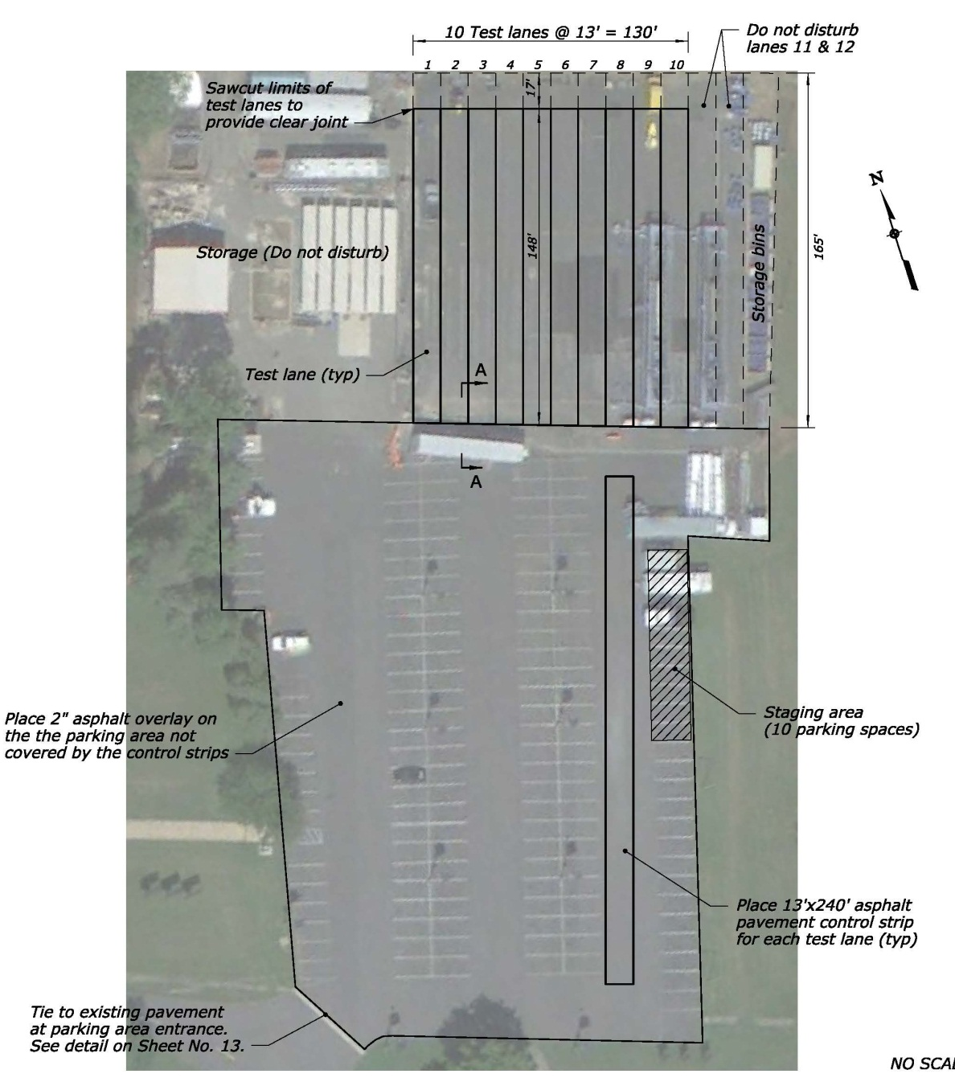

Slide 13
In each Lane there are 4 Test Sites
Current planning is to use only 1 of 4 for the “core of the experiment”
Leave 3 other sites to explore the following at a later date…possibly?:
Long term aging (natural or accelerated)
Rehab Study: How Deep Should We Mill?
Extension of life from pavement preservation treatments
3
4
1
2

Slide 14
12’ x 7’ => 96 Cores
12’ x 12’ => 225 Cores
12’ x 15’ => 270 Cores
Total = 591 Cores

Slide 15
Laboratory Characterization
Field Core Testing @ 0, 1, 2, 3, 6, 12, 18, 24, 36 months + Before & After each ALF Test
Plant Produced Mix Laboratory Tests on Immediate Compacted, Reheated, Long Term Oven Aged
Mix Design & Laboratory Batched Tests on Short Term Oven Aged and Long Term Oven Aged
Hamburg WT, |E*|, Fatigue, TTI Overlay, SST RSCH
High Temp IDT, SCB, TSRST , Extract & Recover Binder
Hamburg WT, |E*|, Fatigue, TTI Overlay , Beam Fatigue
Flow# 3 types, SCB, TSRST , Extract & Recover Binder
Hamburg WT, |E*|, Fatigue, TTI Overlay
Flow# 3 types, SCB, TSRST , Extract & Recover Binder

Slide 16
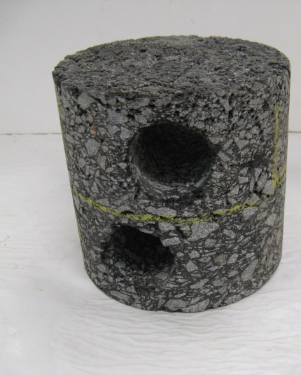
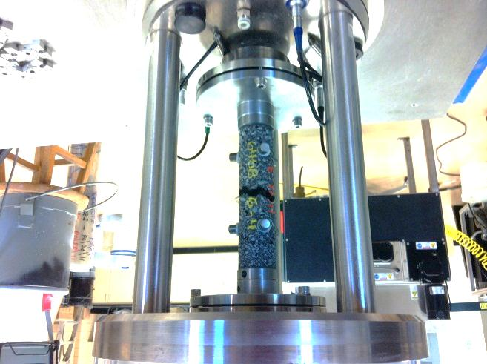
Lab Characterization to Address Field Sequencing

Slide 17
Next Steps
Construction coordination meeting July 18th 2012
Gather RAP/WMA ETG input on July 24th 2012
November 2012 – 95% PS&E Review
01/30/2013 - ADVERTISE
02/12/2013– Pre-Bid Conference
03/28/2013 - OPEN BIDS
04/2013 - AWARD
04/2013 - P + P BONDS
05/2013 - Effective Notice To Proceed
07/2013 - End Schedule A Construction
8-9/2013 – Begin APT Loading

Slide 18
Fed Biz Ops Advertisement
Search “TFHRC 50(3)”
https://www.fbo.gov/index?s=opportunity&mode=form&id=936d1c9bb2c4d5c3a155c2593c58707a&tab=core&tabmode=list&=

Slide 19
Questions? Comments?? Criticisms???

