Slide 1

2013 Concrete Pavement Construction at MnROAD
TRB AFD40 Monthly Seminar
September 12th, 2013
Tom Burnham, P.E.
Minnesota Department of Transportation
Office of Materials and Road Research

Slide 2
MnROAD 2013 Project Themes
Innovation
Preservation
Sustainability

Slide 3
MnROAD 2013 Construction (June)
  Cell 613: Maximum recycled content mix
    7.5” Concrete pavement
    High percentage (75%) of recycled concrete used as coarse aggregate in concrete mix
    Innovative (narrow) pre-formed joint seals
    Geotextile drains under dowel baskets
  Cells 160-163: Fiber-reinforced bonded concrete overlay of asphalt (whitetopping)
    4” FRC over 7” existing HMA (milled)
    5” FRC over 6” existing HMA (milled)
    Sealed vs unsealed joints
  Cells 140, 240: Ultra-thin FRC unbonded concrete overlay of concrete
    3” FRC over 7” existing PCC
    Fabric interlayer (2 thicknesses)

Slide 4
MnROAD 2013 Construction
(September/October)
  Cell 39: Resurface pervious concrete overlay
    Diamond grind existing 4” pervious concrete overlay to restore ride quality
    Determine feasibility of process (clogging?)
  Cell 32: Thin concrete pavement rehabilitation
    Repairs on 5” concrete pavement constructed in 2000
    Full-depth half panel replacements
    Innovative load transfer devices (CoVex dowels)
    Retrofit dowels (round and plate)
    Diamond grind surface to remove significant joint faulting

Slide 5
MnROAD Cell 613
  High Percentage Recycle Concrete Aggregate Mix
7.5” PCC
75% coarse agg=
Recycled PCC
Var thickness
Class 1 (2008)
Var thickness (5”?)
Class 5 (2008)
Silty/Clay

Slide 6
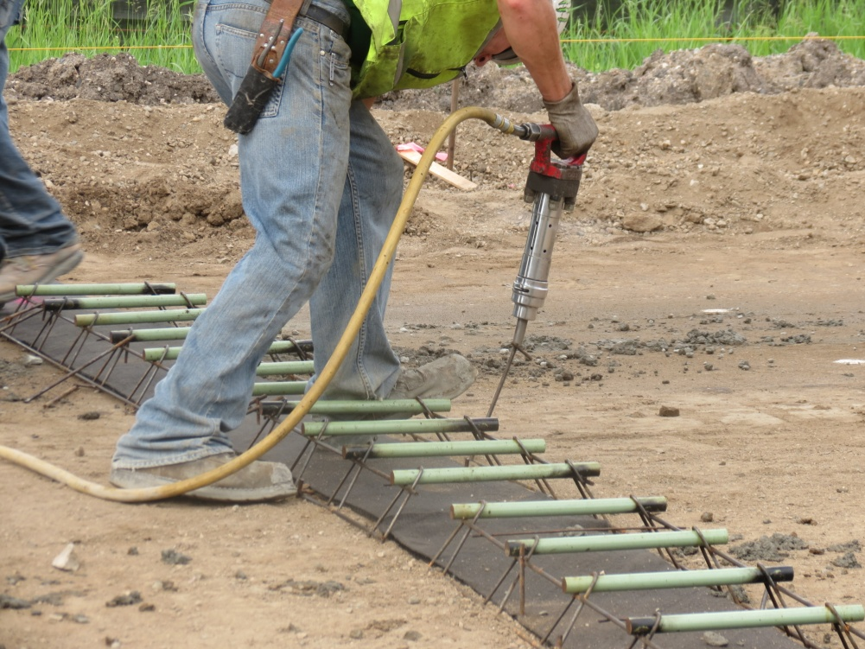
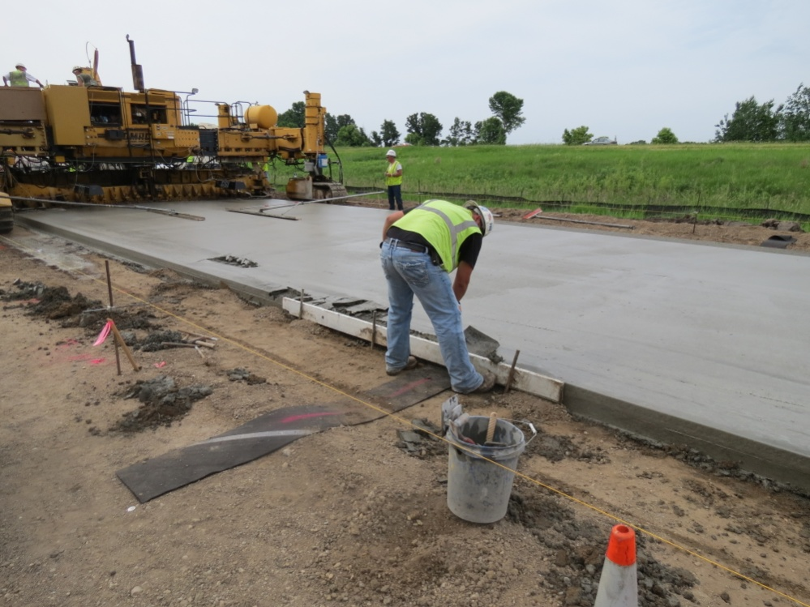
MnROAD Cell 613
  Geotextile joint drains
RoaDrain geotextile supplied by Tensar

Slide 7
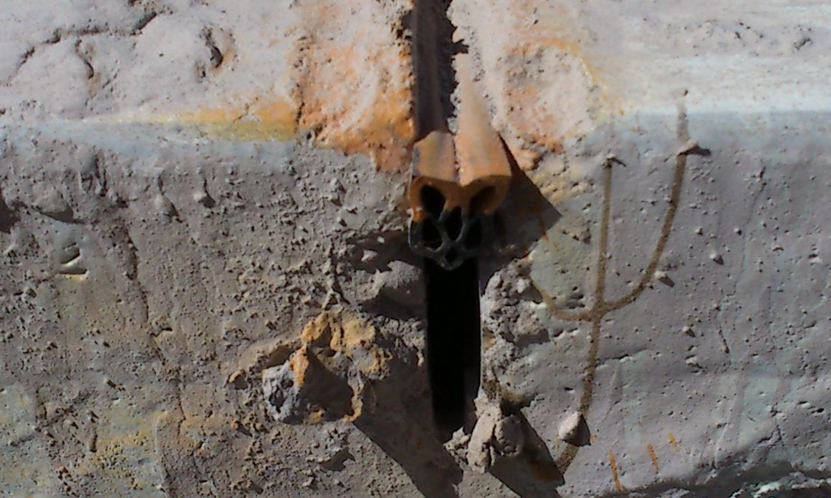
MnROAD Cell 613
  ¼” Preformed Seals
Seals supplied by D.S. Brown

Slide 8
MnROAD Cells 160-163
  Fiber Reinforced Concrete Overlay of Asphalt (Whitetopping)
5” FRC
6 lbs/yd³ Propex
Sealed/unseal jts
4” FRC
6 lbs/yd³ Propex
Sealed/unseal jts
6” HMA
7” HMA
Silty/Clay
Silty/Clay

Slide 9
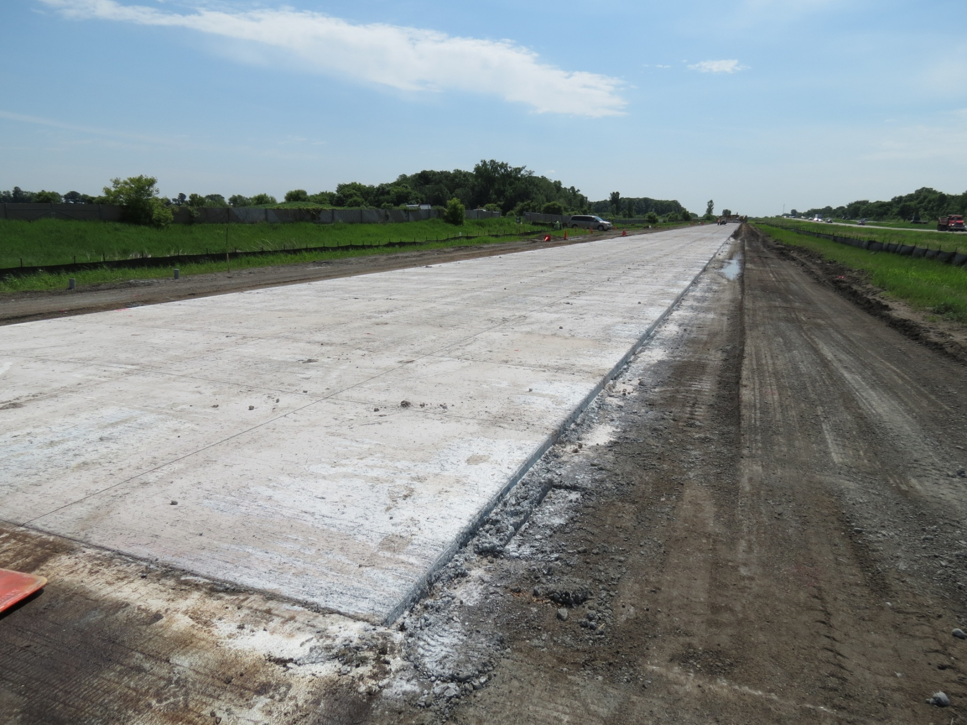
MnROAD Cells 160-163

Slide 10
  Fiber Reinforced Concrete
  Performance-based specification (20% residual strength):
  ASTM C1609: Standard Test Method for Flexural Performance of Fiber-Reinforced Concrete (Using Beam With Third-Point Loading)
Element Materials Technology, June 5, 2013

Slide 11
MnROAD Cells 140 & 240
  Ultra-thin Fiber Reinforced Concrete Overlay of Existing Concrete Pavement
3” FRC
6’x6’ panels, 6 lb/yd³ Propex
Fabric interlayer (std and thin)
Var thickness PCC
5.5-7” design (1993)
5” Class 5 Sp (1993)
Silty/Clay
Silty/Clay

Slide 12
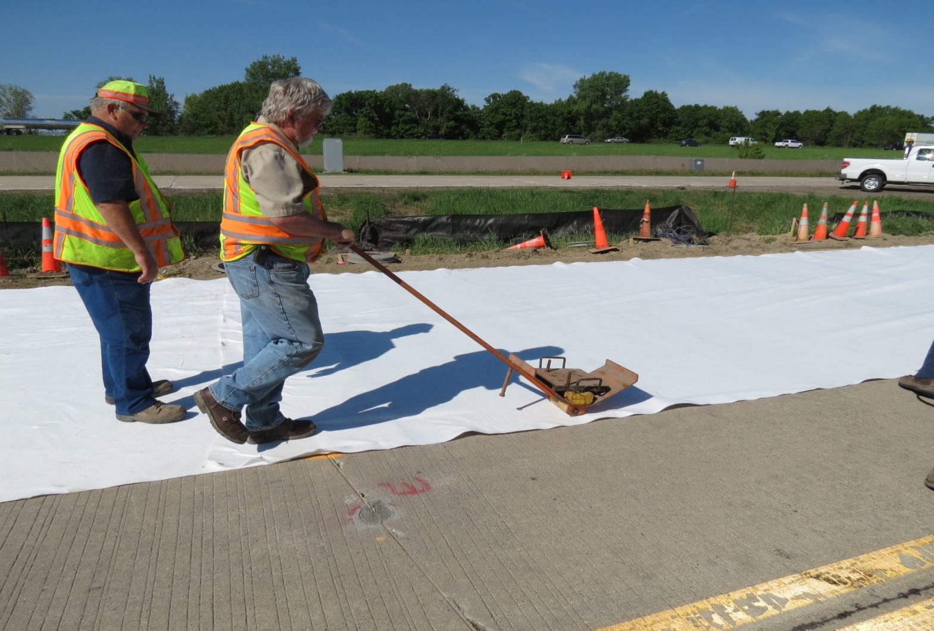
MnROAD Cells 140 & 240
  Nonwoven Geotextile Fabric Interlayer
Used glue to secure standard/thin fabric to existing concrete
Fabric supplied by Propex

Slide 13
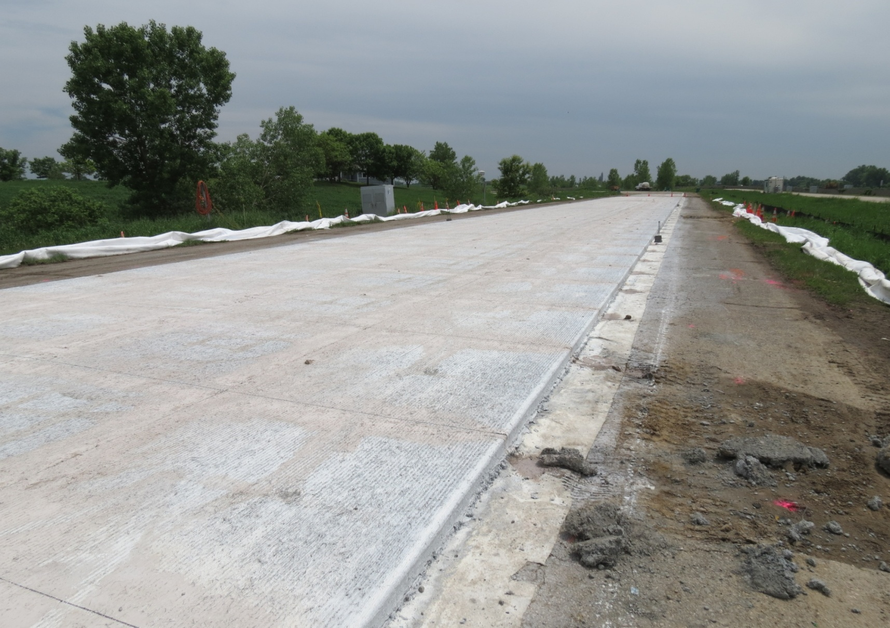
MnROAD Cells 140 & 240
Fibers supplied by Propex

Slide 14
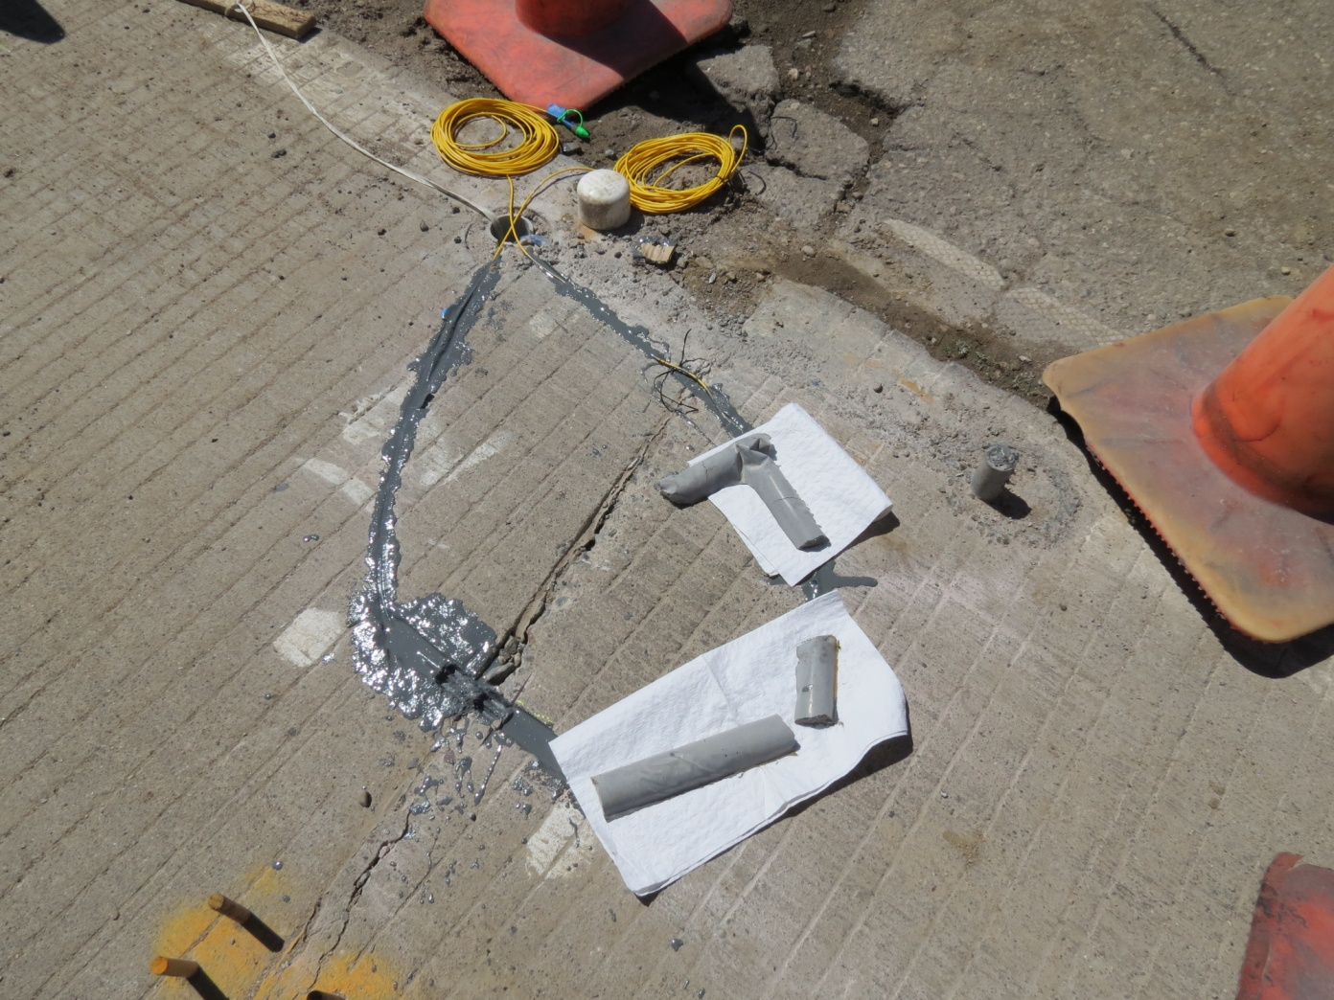
MnROAD Cells 140 & 240
  Fiber Optic Sensors
Partnership with Missouri University of Science and Technology and NDSU

Slide 15
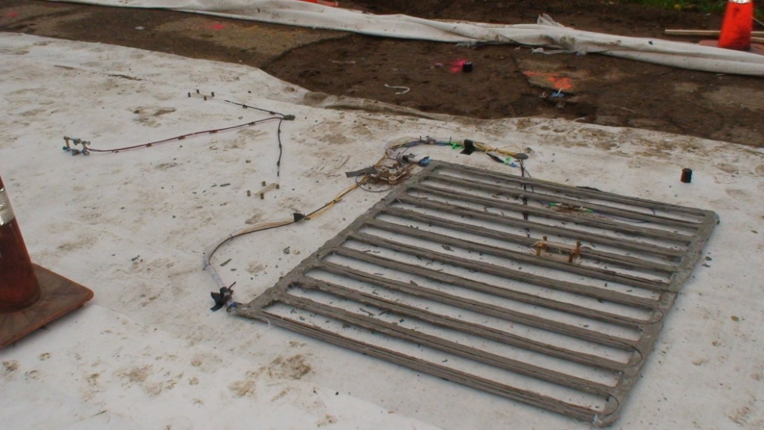
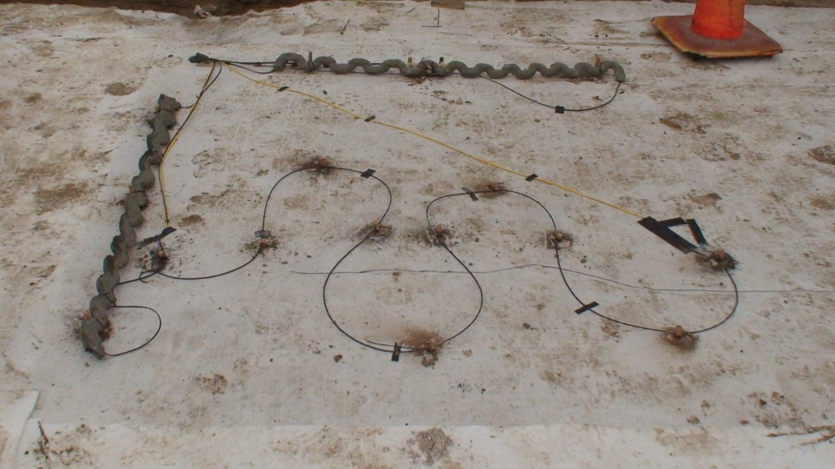
MnROAD Cells 140 & 240
  Fiber Optic Sensors
Partnership with Missouri University of Science and Technology and NDSU

Slide 16
MnROAD Cell 39
  Thin Pervious Bonded Concrete Overlay
4” Pervious PCC (2008)
6”PCC (1993)
5” CL 5
Silty/Clay

Slide 17
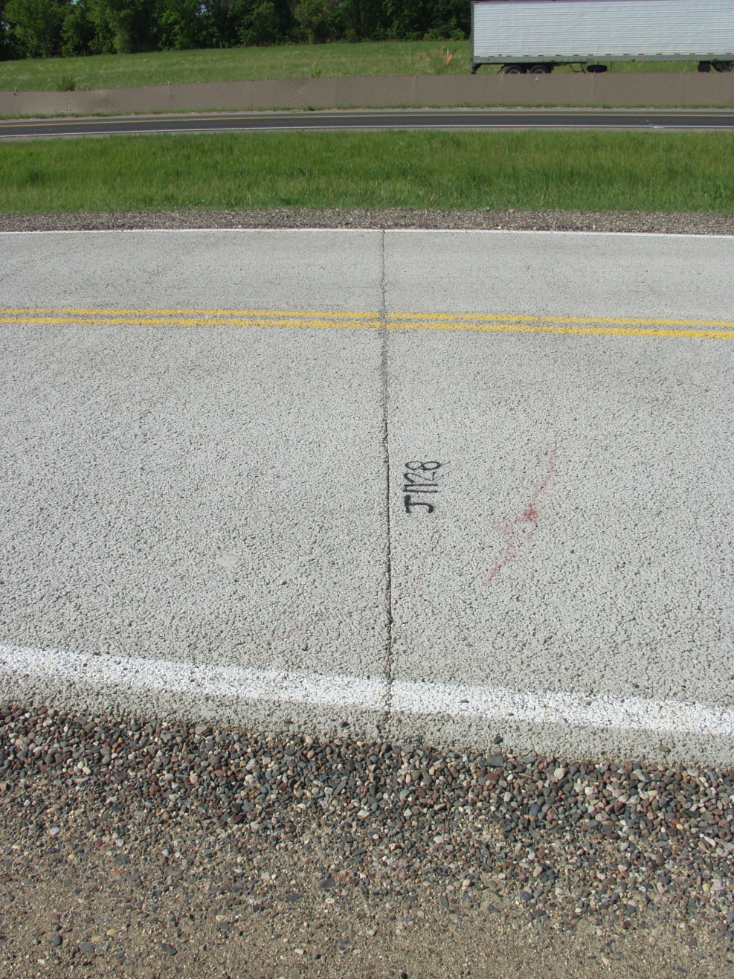
MnROAD Cell 39
  Thin Pervious Bonded Concrete Overlay
Constructed with rough ride
Numerous panel cracks, areas of debonding
Scheduled to be diamond ground to improve ride quality
Will assess ability of pervious pavements to be diamond ground (clogging?)
May 2009

Slide 18
MnROAD Cell 32
  Rehabilitation of 5 inch thick concrete pavement
  Half panel full-depth concrete replacement, retrofit dowel bars and plates, diamond grinding to improve ride quality

Slide 19
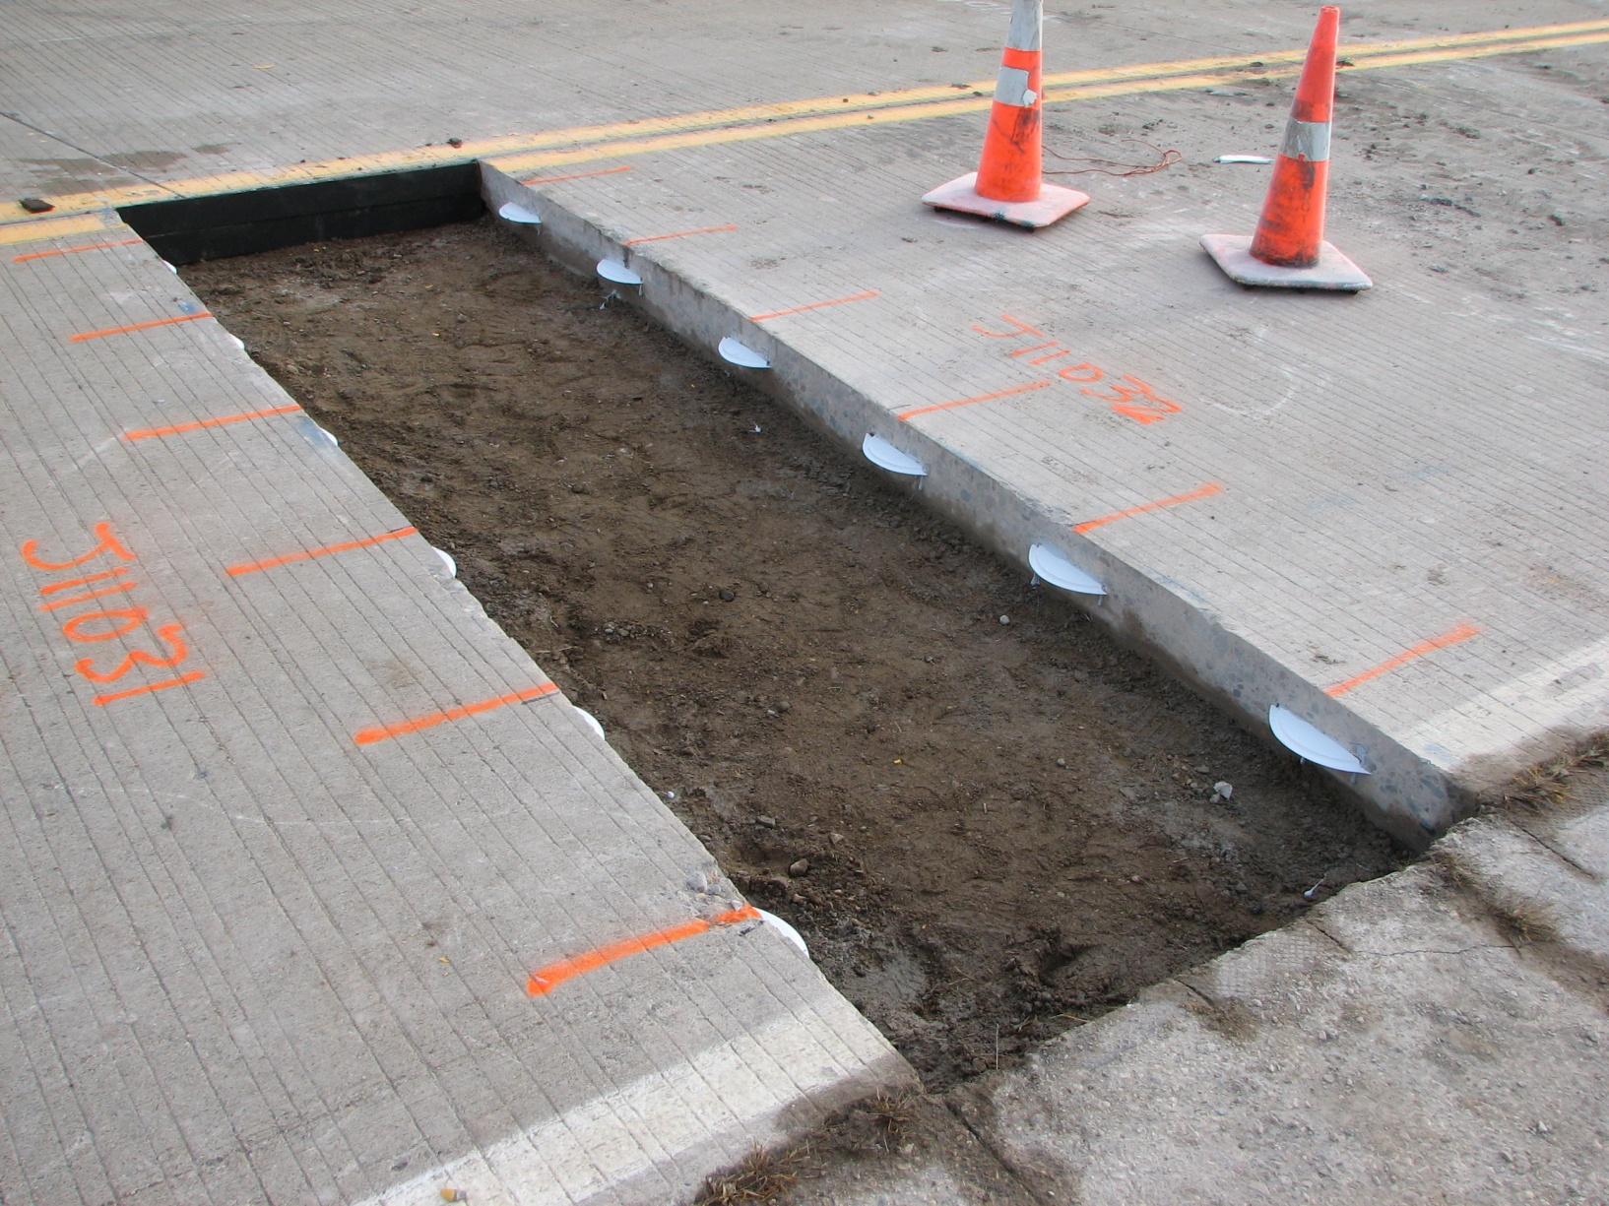
PNA CoVex Plate Dowels

Slide 20
Questions?????

