Slide 1

Status of the first experiment at the PaveLab
Fabricio Leiva-Villacorta, PhD
Jose Aguiar-Moya, PhD
Luis Loria-Salazar, PhD
August 31st, 2015

Slide 2
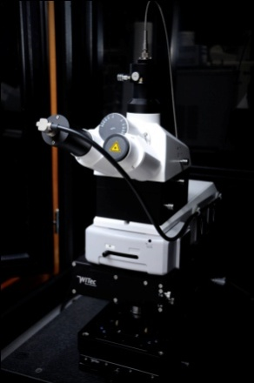
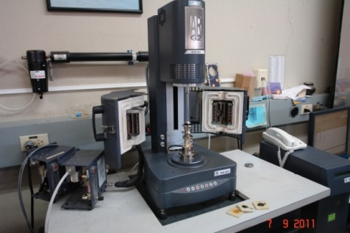
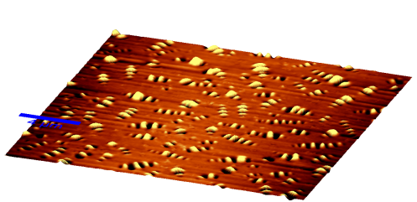
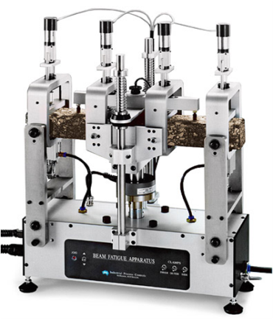
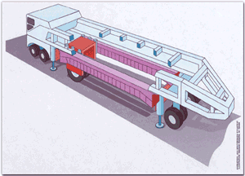
Research Philosophy…
NANO
MICRO
FULL SCALE
MACRO

Slide 3
Phase I Experiment
4 Different pavement structures, 8 sections
Compare
  Asphalt concrete thicknesses
  Granular vs. cement treated base
Evaluate construction practices
Painting evaluation under tropical climate

Slide 4
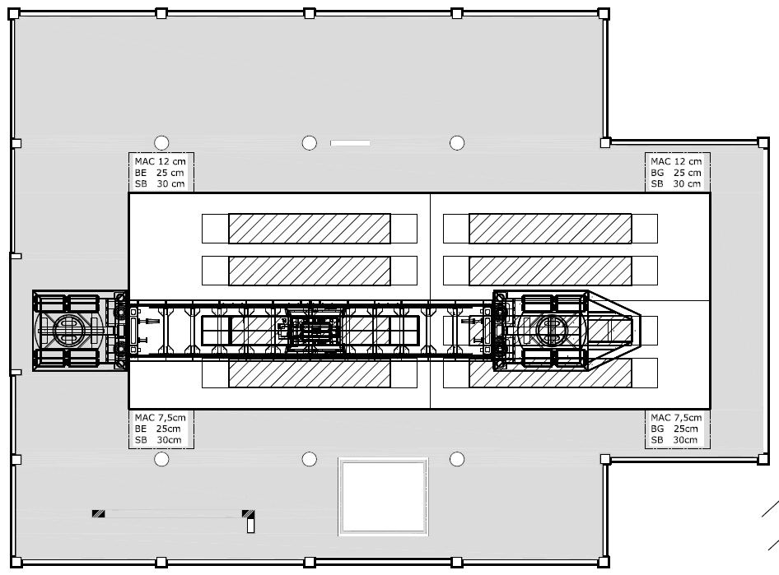

Real pavement

Slide 5
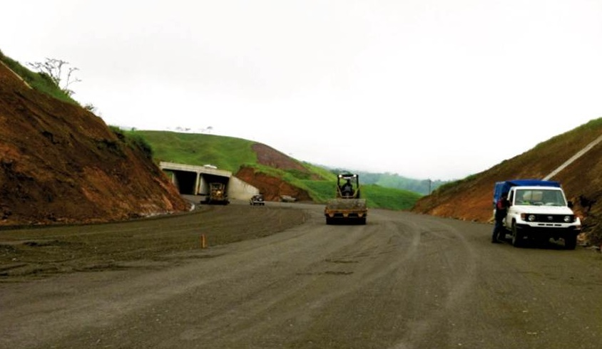
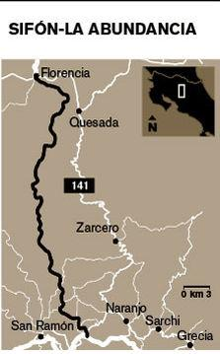

Phase I Experiment
Sifón-La Abundancia

Slide 6
Instrumentation
Laser profiler
Pavement Strain Transducers (PAST)
Soil Pressure Transducers (SOPT)
Multi-Depth Deflectometer (MDD)
Road Surface Deflectometer (RSD)
Thermocouples

Slide 7


Gauge Array
30 cm
60 cm
90 cm
MDD
Thermocouple
MDD
Section Length = 6.0 m
HMA
GB/CTB
Subbase
Subgrade

Slide 8
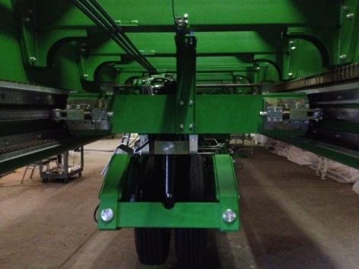
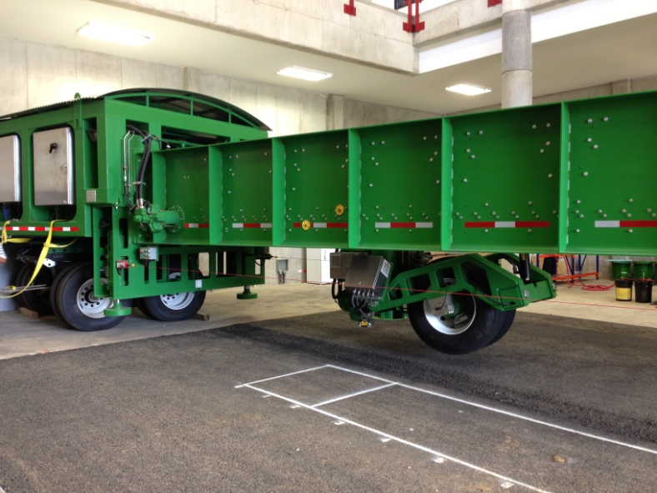
Test Settings
  20,000 bi-directional load repetitions per day
  Carriage speed: 10 km/hr
  Applied load: 40, 60, 70, 80 kN
  Test tire: Dual 11R22-5
  Wheel wandering: 100 mm
  Dry condition
  23/7

Slide 9
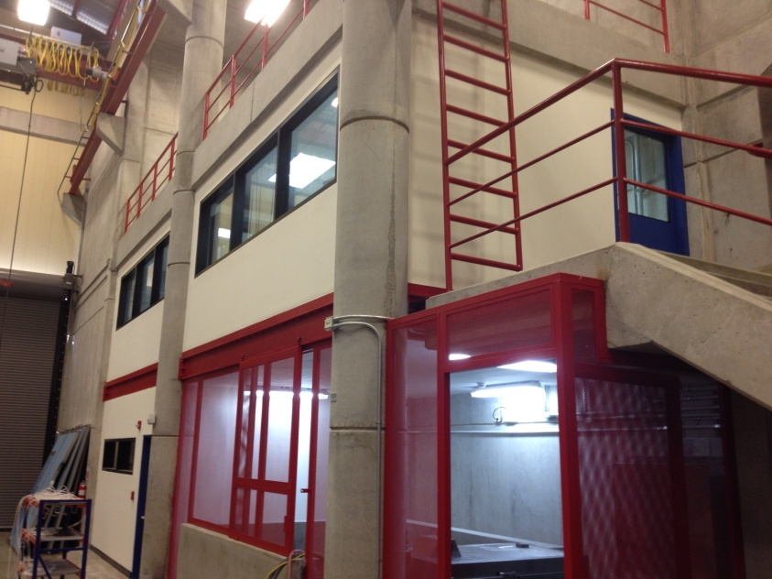
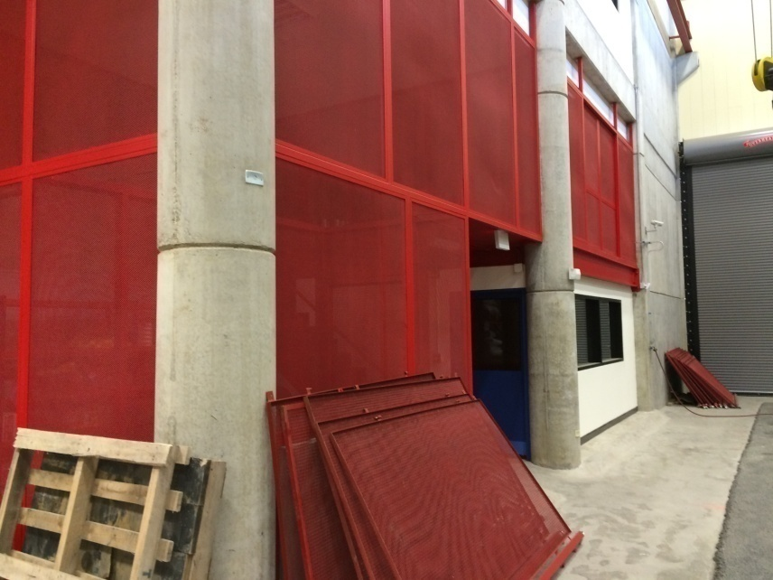
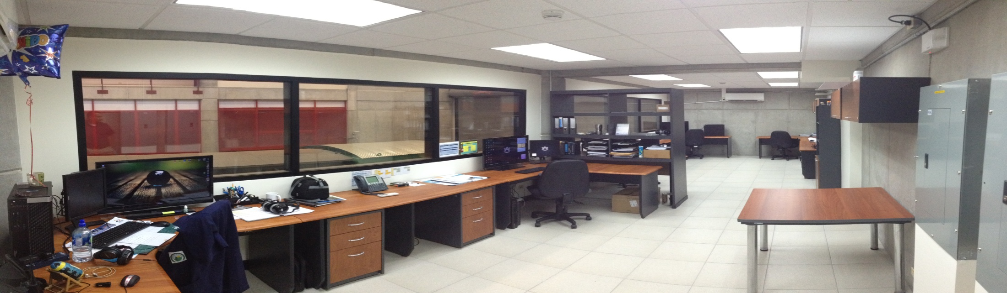
Facility improvements

Slide 10
Material Properties
Granular and CTB
Property | Subgrade | Subbase | Base | Base for CTB | CTB
Wopt (%) | 52.5 | 8.9 | 8.6 | 11.5 | 11.5
gd max (kg/m³) | 1056 | 2204 | 2217 | 2013 | 2013
LL | 56 | - | - | 24.8 | -
PI | 16 | NP | NP | 4.4 | -
CBR, % | 6.6 | 95 | 95 | Pend. | 35 kg/cm2
HMA
QC |  | Specs
NMAS, mm | 19
AC, % | 4.9
VMA | 14.9 | Min 14%
VFA | 72 | 65-75%
Estability, Kg | 1482 | Min 800
Flow | 30 | 20-35 cm/100
DP | 1.04 | 0.8-1.3
Sieve | Passing, % | Specs
25.4 mm | 100 | 100
19.1 mm | 99 | 90-100
12.7 mm | 77 | 70-80
9.5 mm | 65 | 55-65
N 4 | 41 | 35-43
N 8 | 28 | 22-30
N 16 | 20 | 16-22
N 30 | 14 | 11-17
N 50 | 10 | 7-14
N 200 | 4.9 | 2-5.8

Slide 11
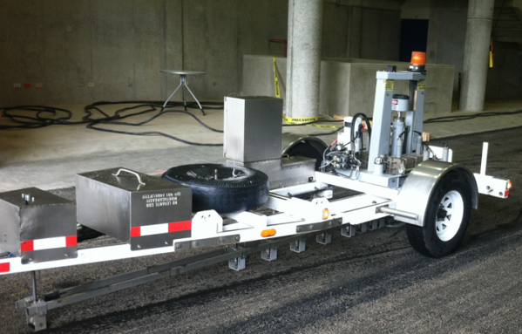
FWD
FWD
Layer | M (MPa) | M (ksi)
HMA | 3800 | 551
CTB | 1200 | 174
Base | 170 | 25
Subbase | 140 | 20
Subgrade | 70 | 10

Slide 12
Laser Profile
MDD´s

Slide 13
Permanent Deformation-Laser
Average deformation (entire section)

Slide 14
IRI
Average of wheelpath

Slide 15
Stress @ subgrade
AC3 pressure cell did not work

Slide 16
MDD´s
30 cm
60 cm
90 cm
MDD
Thermocouple
MDD
Section Length = 6.0 m

Slide 17
Max. Deflection @ 40 kN - MDDs
Surface
Subgrade

Slide 18

MDD Backcalculaded Layer Moduli
AC1
Deflections @ 40 kN
Average “n” value = -0.4
CR-ME

Slide 19
RSD-AC1
Deflections @ 40 kN
30 cm
60 cm
90 cm
100 cm
RSD – N1
RSD – N2
RSD – S1
MDD
MDD
RSD – S2
Construction variability !!!

Slide 20

RSD-AC4
2 different locations along the center line

Slide 21
Strain Transducers
AC2 @ 2k rep.
AC2 @ 1M rep.
Strains @ 40 kN

Slide 22

Strain Transducers
AC2
Water added to surface
Strains @ 40 kN

Slide 23
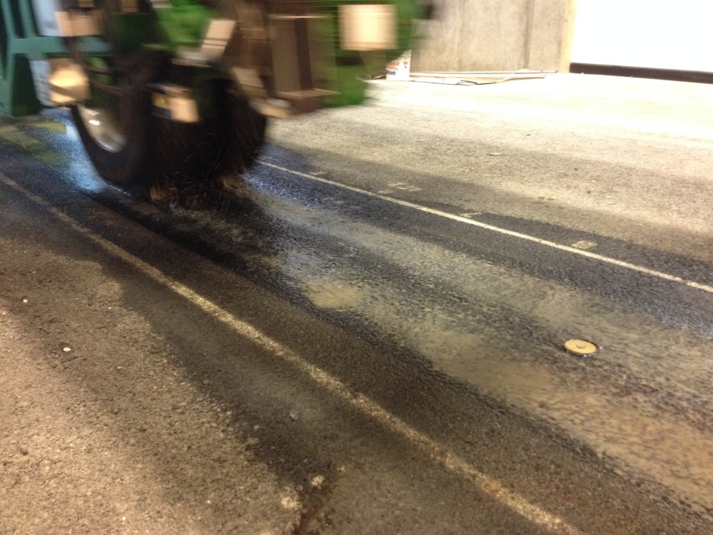
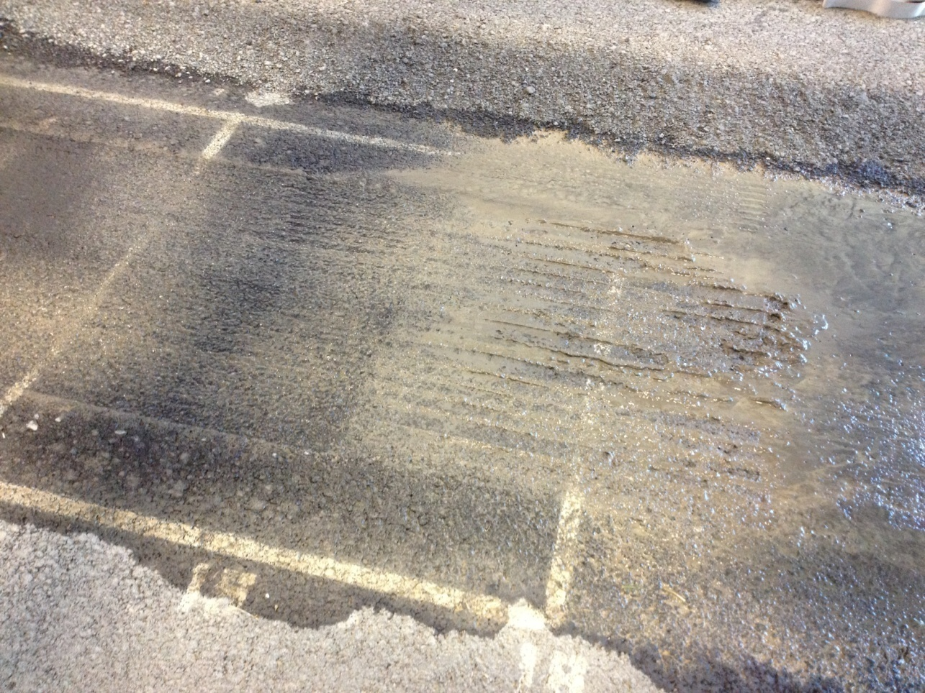
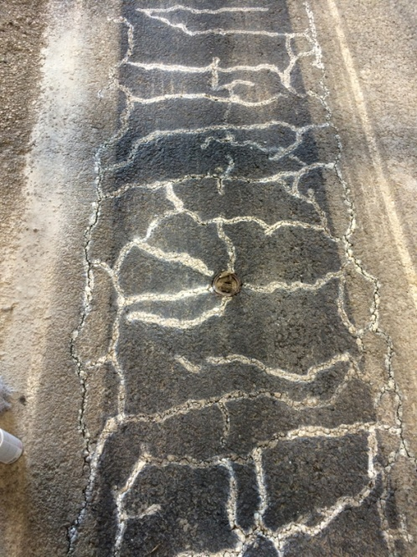
AC2

Slide 24

Strain Transducers
Evidence of fatigue cracking
AC3
Strains @ 40 kN

Slide 25
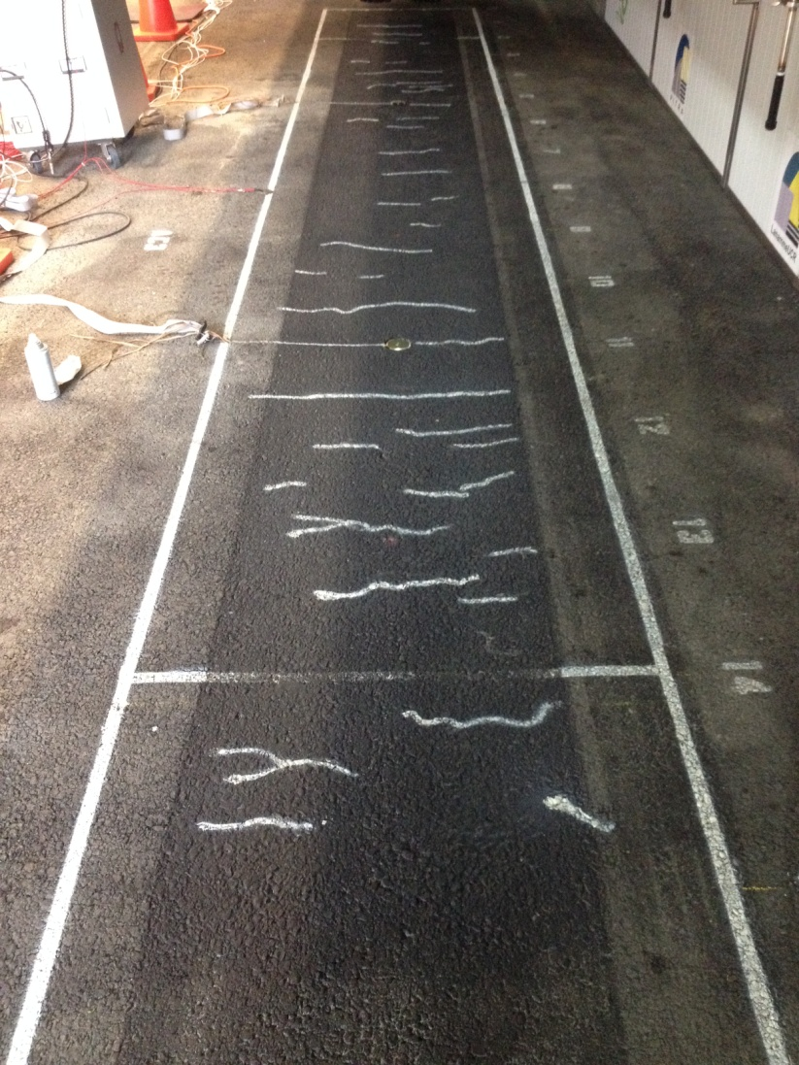
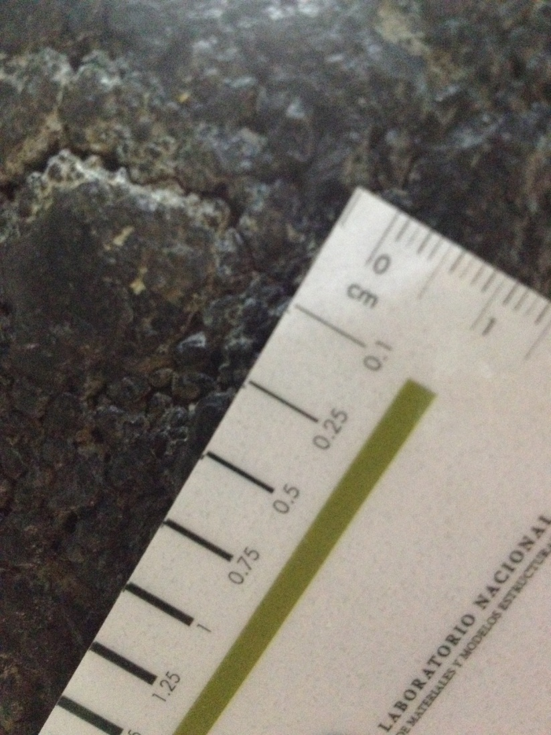
Fatigue cracking
AC3

Slide 26


Just over 50 Million ESALs
Test section | Repetitions | ESALS
001 AC1 | 1 000 000 | 10 708 004
002 AC4 | 1 500 000 | 21 550 195
003 AC2 | 1 000 000 | 9 350 541
004 AC3* | 1 240 000* | 11 066 122*
*Until August 2015

Slide 27
Deflection Analysis
Initial state
Captures non-linear behavior of the lowers layers.

Slide 28
Deflection Analysis
Failure State
2.5 – 3 times higher
More intensified non-linear behavior of the lowers layers. Exhibits the presence of the test pit concrete support layer (shallow rigid layer).

Slide 29
Lab. Characterization
Sample | APA (AASHTO TP 63) |  | HWT (AASHTO T324) |  | FN (AASHTO TP 79-11)
 | % Air Voids | PD, mm | % Air Voids | PD, mm | FN @ 58 °C | FN @ 52 °C | FN @ 46 °C
Plant Produced | 7.7 | 2.751 | 7.5 | 3.35 | 178 | 418 | 1523
Lab Prepared | 7.9 | 2.121 | 8 | 8.28 | 153 | 307 | 1493
Sample | TSR (AASHTO T283) |  |  | Mr (AASHTO TP31-96/ASTM 4123)
 | 1 Cicle | 3 Cicles | 6 Cicles | % Air Voids | Mr @ 5 °C, MPa | Mr @ 25 °C, MPa | Mr @ 40 °C, MPa
Plant Produced | 101 | 85 | 77 | 7.7 | 17362 | 5703 | 2207
Lab Prepared | 96 | 78 | 62 | 7.2 | 17522 | 5619 | 2121

Slide 30
Transfer functions
Perm. Def. HMA
Fatigue HMA
Perm. Def. Gran. Base
Perm. Def. Subgrade
Lab developed models are being calibrated with HVS results

Slide 31
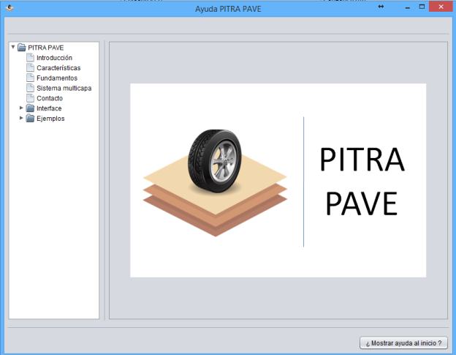
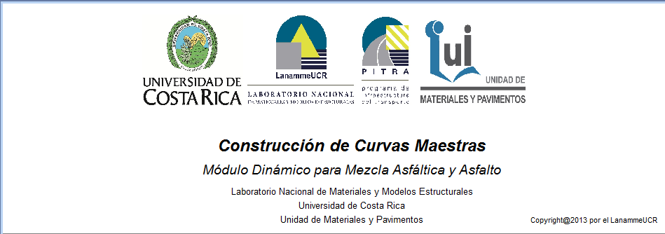
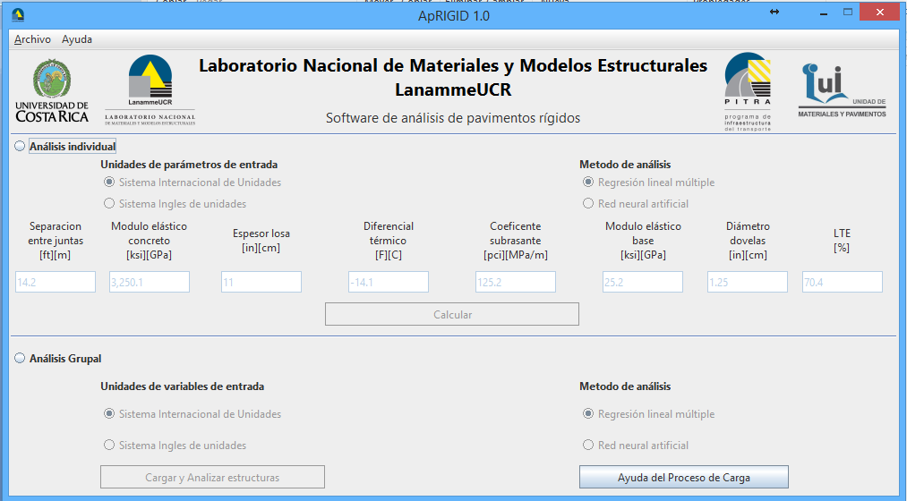
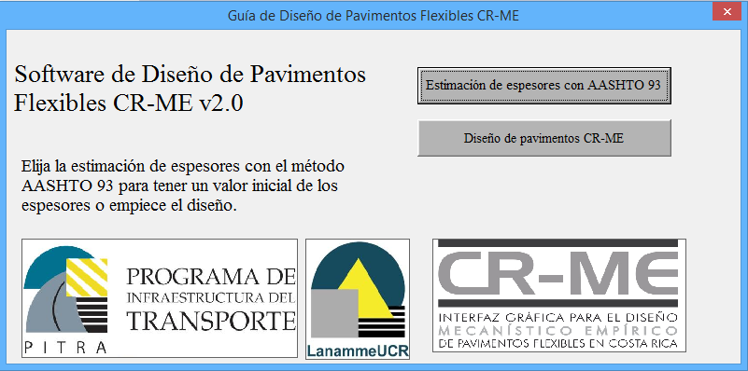
Linked to software development
MLET
HMA master curves software
AppRIGID
CR-ME 2.0 –EXCEL BASED-

Slide 32
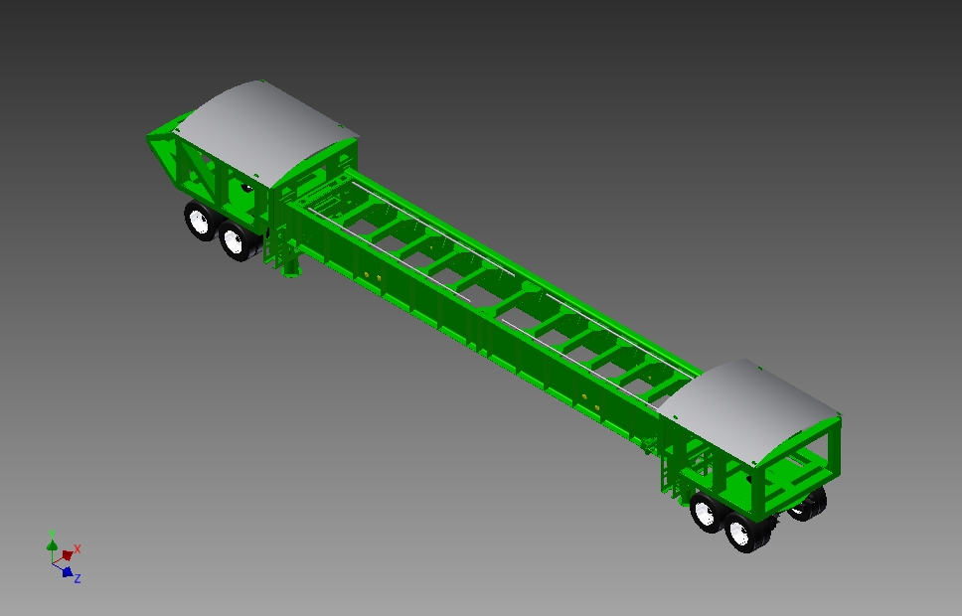
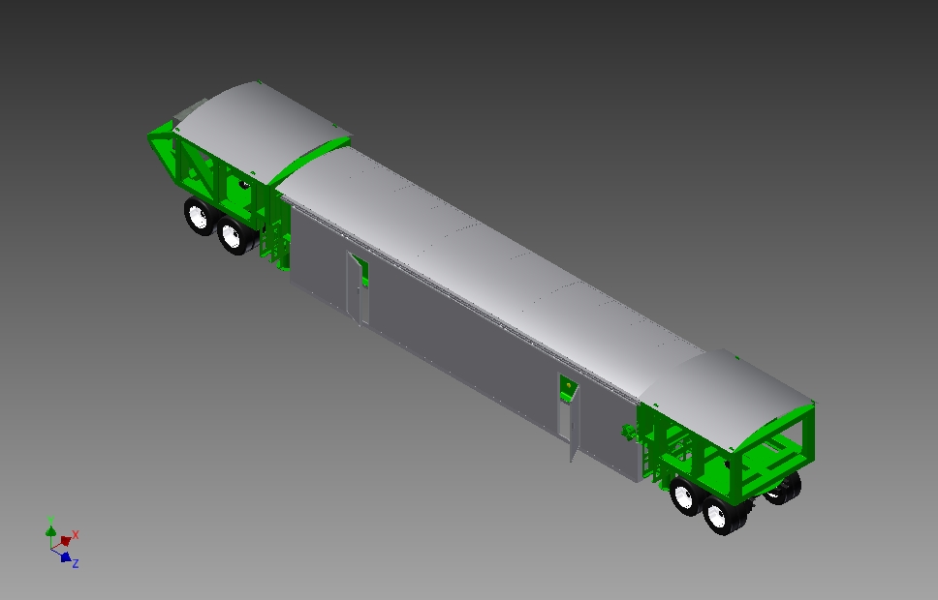
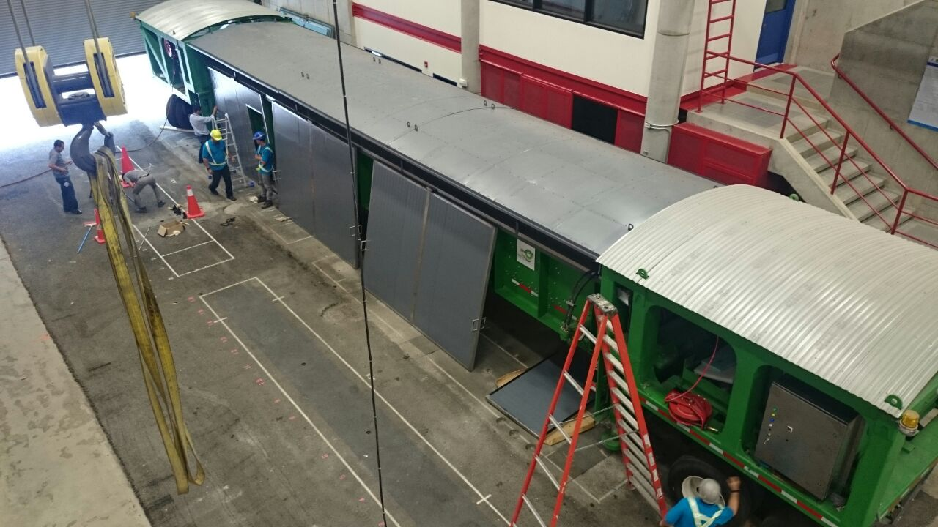
FUTURE
Climatic Condition Chamber
Infrared + UV: Temperature + aging
Raining system→ moisture
Water table simulation

Slide 33
Summary
Increase in Deflections
Increase in vertical stress
Increase in horizontal strain
Visible low severity cracks (fatigue) within effective section for AC2, AC3 (granular base).
Cracking pattern initiates with transverse cracks @ 30 cm, then @15, finally blocks are formed
Cumulative damage

Slide 34
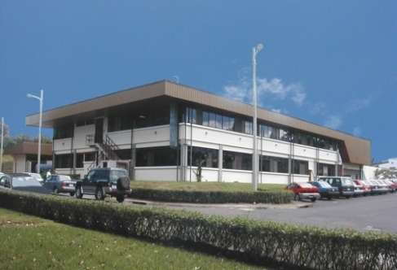
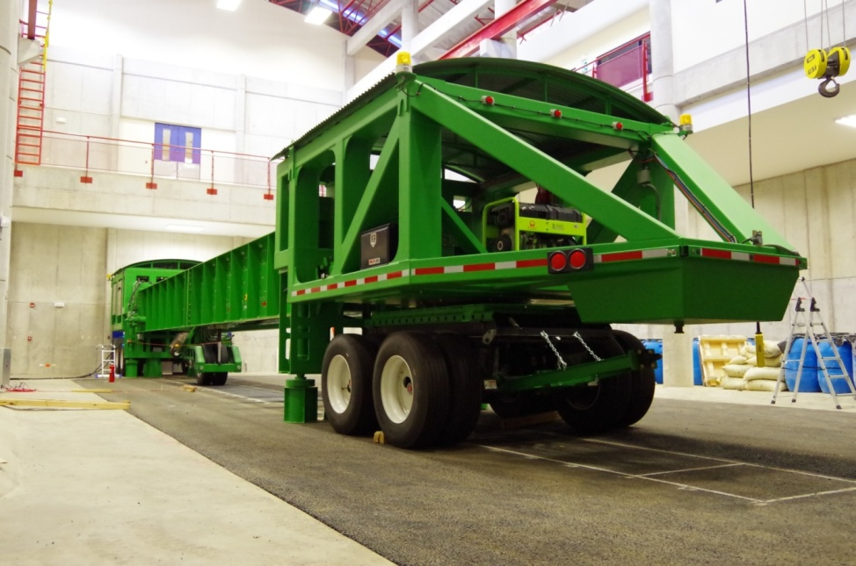
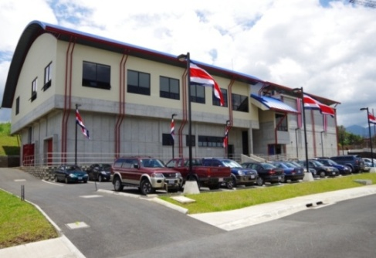
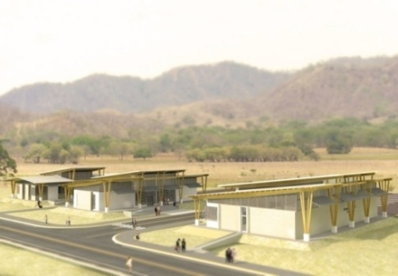
Thank You!
http://www.lanamme.ucr.ac.cr/pavelab

Slide 35

APT 2016
Important dates
October 9, 2015: Deadline for submission of full paper for peer review
January 15, 2016: Comments, notification of acceptance/rejection of full paper
March 11, 2016: Submission of full, revised paper
September 19-21, 2016: APT 2012 Conference

